Slide 1
Topic 3: Basic Elements of Supply and Demand

Slide 2
CHAPTER OUTLINE
The Demand Schedule
The Demand Curve
Market Demand
Forces Behind the Demand Curve
Shifts in Demand
The Supply Schedule
The Supply Curve
Forces Behind the Supply Curve
Shifts in Supply
Equilibrium of Supply and Demand
Equilibrium with Supply and Demand
Effect of a Shift in Supply or Demand
Interpreting Changes in Price and Quantity
Supply, Demand, and Immigration
Rationing by Prices
Summary

Slide 3
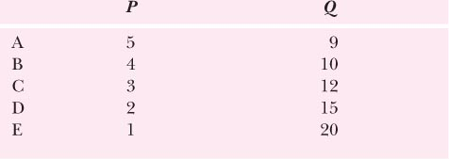
Demand Schedule: Tabular Statement indicating the relationship between price and quantity demanded

Slide 4
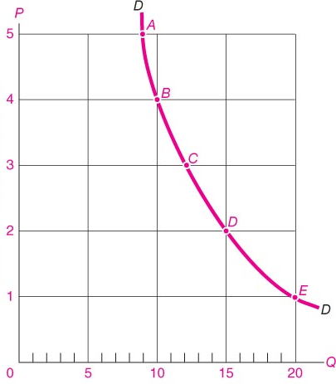
Demand Curve: Graphical Representation of Demand Schedule

Slide 5
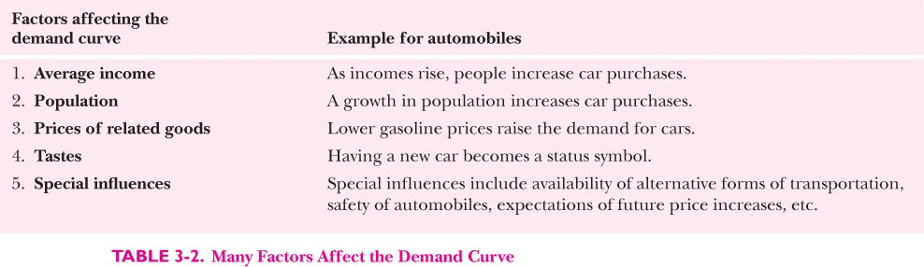
Shifts in Demand Curve due to:

Slide 6
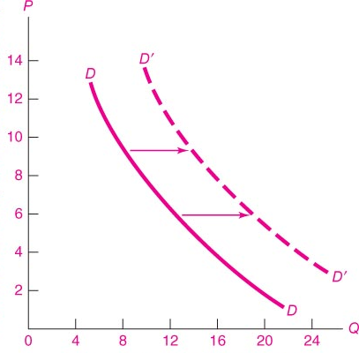
Shifts in demand curve

Slide 7
Basics of Supply

Slide 8
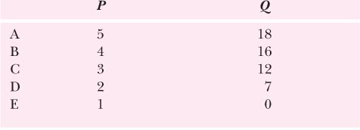
Supply Schedule

Slide 9
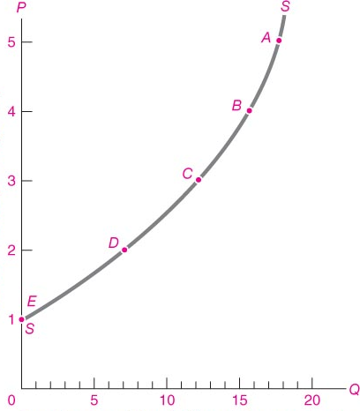
Supply Curve

Slide 10
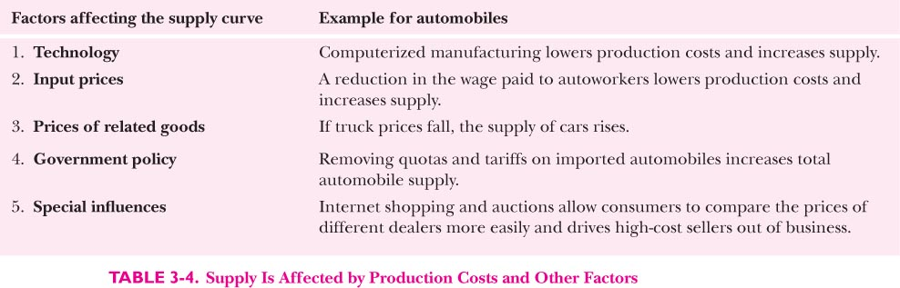
Factors Leading to shift in supply curve

Slide 11
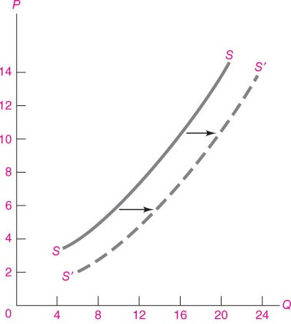
Shifts in Supply Curve

Slide 12
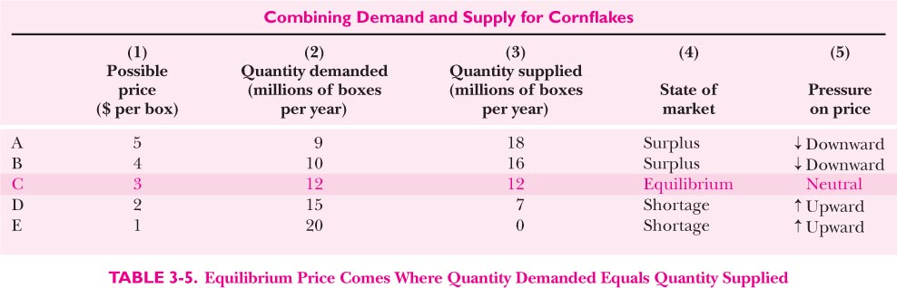
Equilibrium price and quantity traded

Slide 13
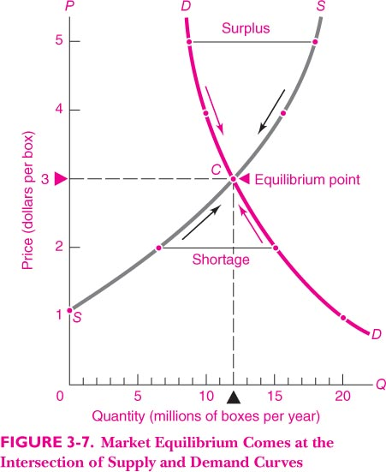

Slide 14
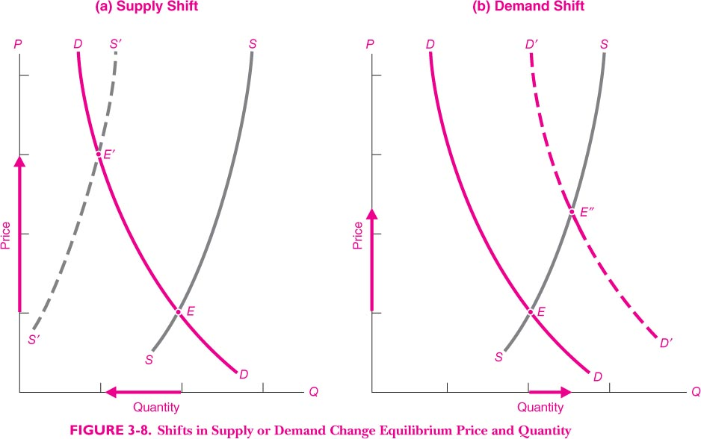

Slide 15
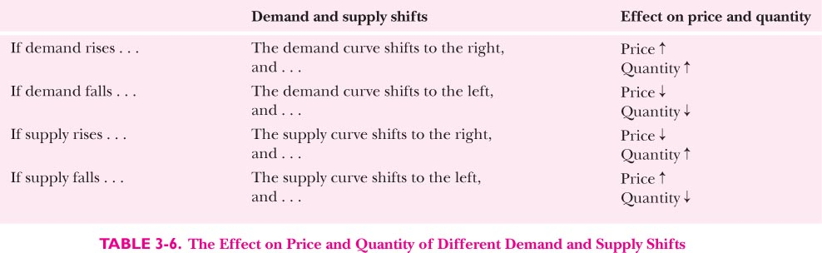

Slide 16
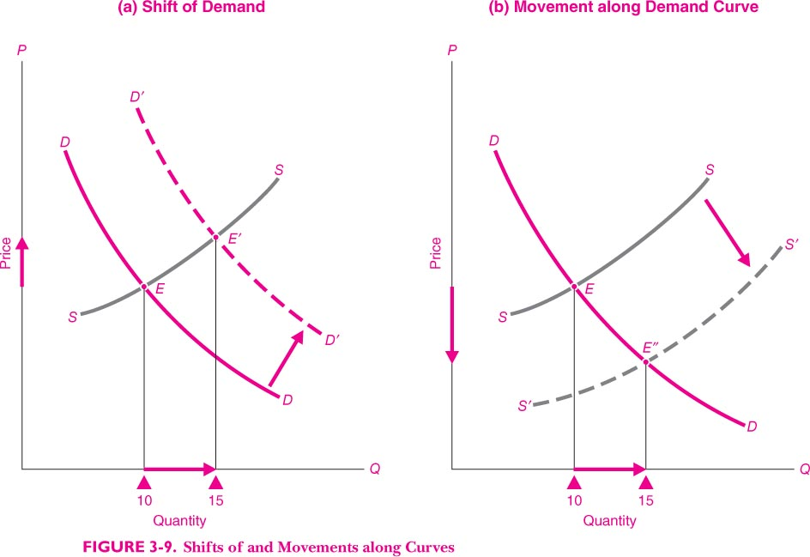
Shifts of and movement along demand curve

Slide 17
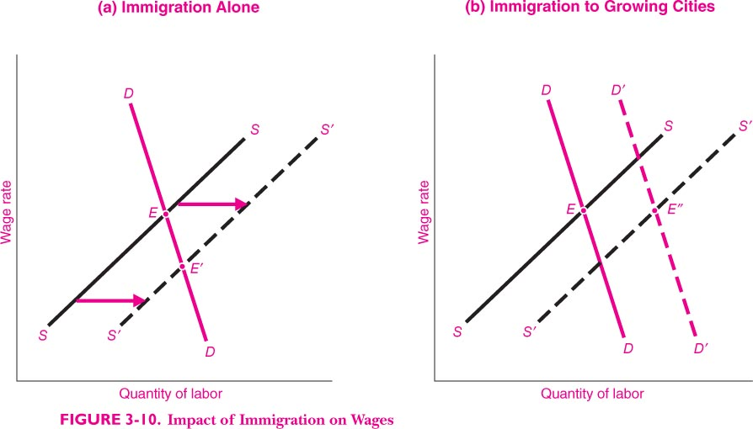
Impact of immigration on wages

Slide 18
Reservation Price
A person’s maximum willingness to pay for something that person’s reservation price.
Reservation price is the price at which he or she is just indifferent between purchasing or not purchasing the good.

Slide 19
Reservation Price

Slide 20
Reservation price and Demand curve

